Slide 1
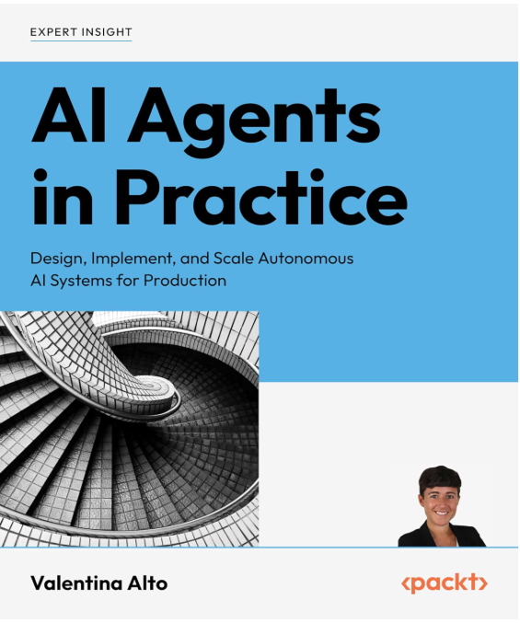
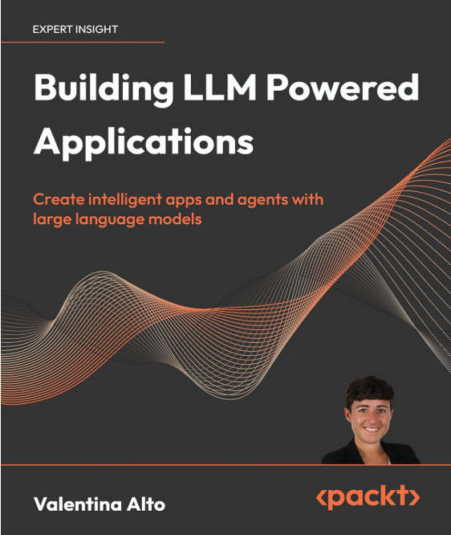
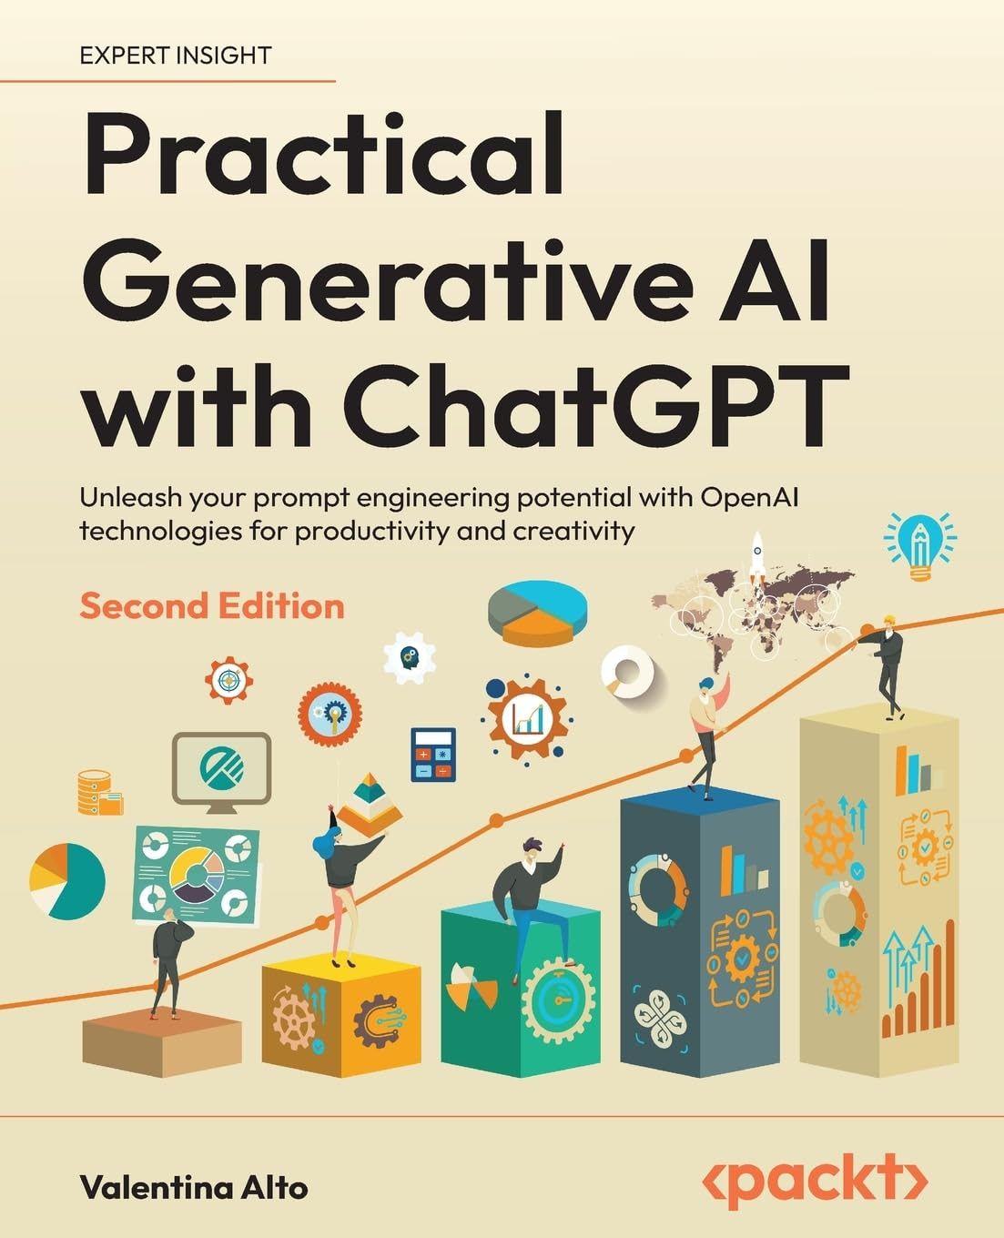
About Valentina Alto
After completing her Bachelor's degree in Finance, Valentina Alto pursued a Master's degree in Data Science in 2021. She began her professional career at Microsoft as an Azure Solution Specialist, and since 2022, she has primarily focused on working with data and AI solutions in the Manufacturing and Pharmaceutical industries. Valentina collaborates closely with system integrators on customer projects, with a particular emphasis on deploying cloud architectures that incorporate modern data platforms, data mesh frameworks, and applications of Machine Learning and Artificial Intelligence. Alongside her academic journey, she has been actively writing technical articles on Statistics, Machine Learning, Deep Learning, and AI for various publications, driven by her passion for AI and Python programming.

Slide 2
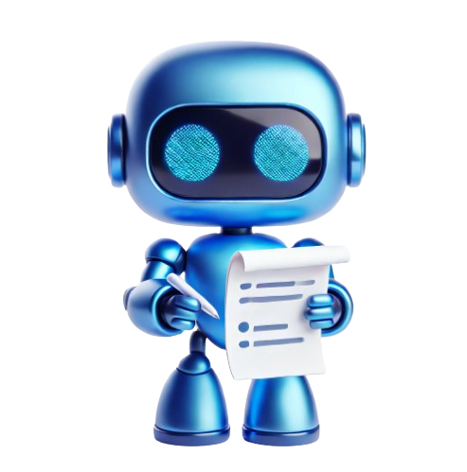
AI AGENTS FOUNDATIONS​ – Day 2
21-06-2025 | Confidential
Demo and Build Your Agent
By Valentina Alto

Slide 3
Agenda
Recap and Setup
Design the Agent from a Challenge Statement
Demo: E-commerce Agent and Code Walkthrough
Hands-on: Design Thinking
Hands-on: Code
Conclusion: Q&A

Slide 4
Recap and Setup
01

Slide 5
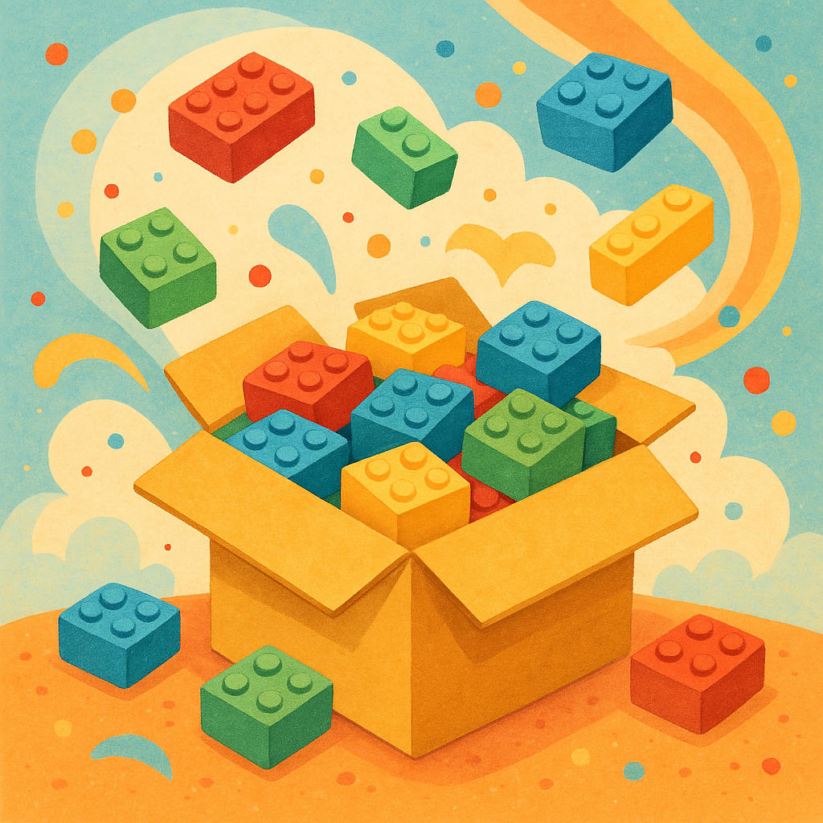
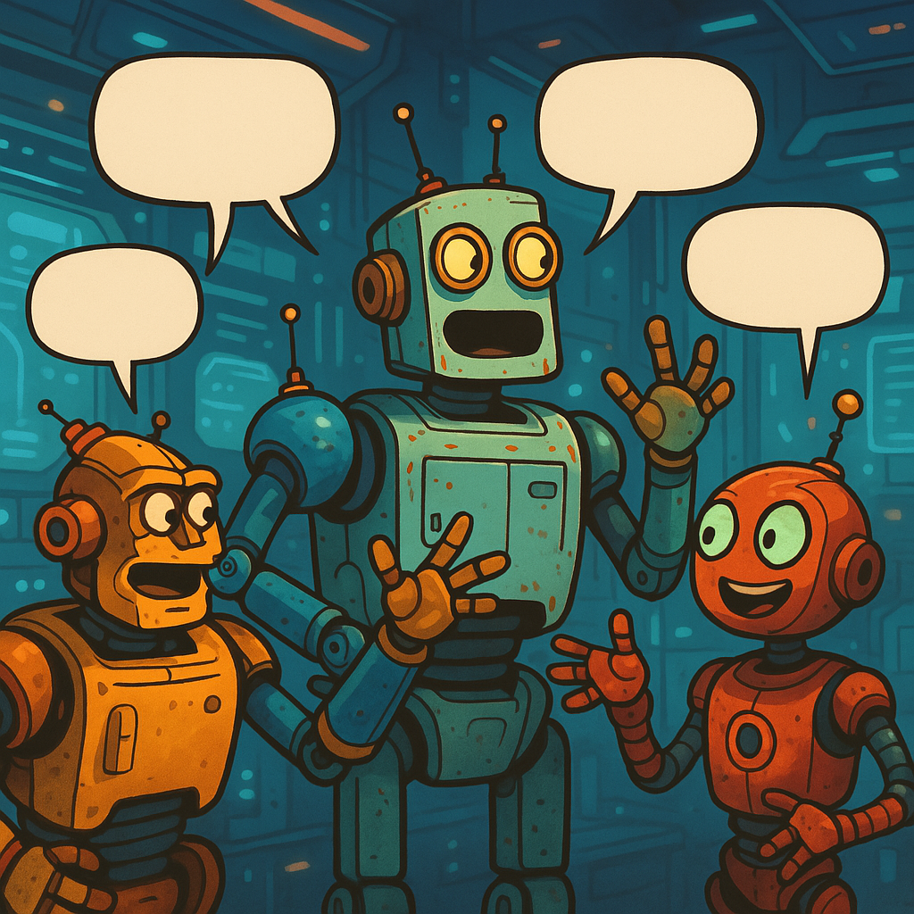

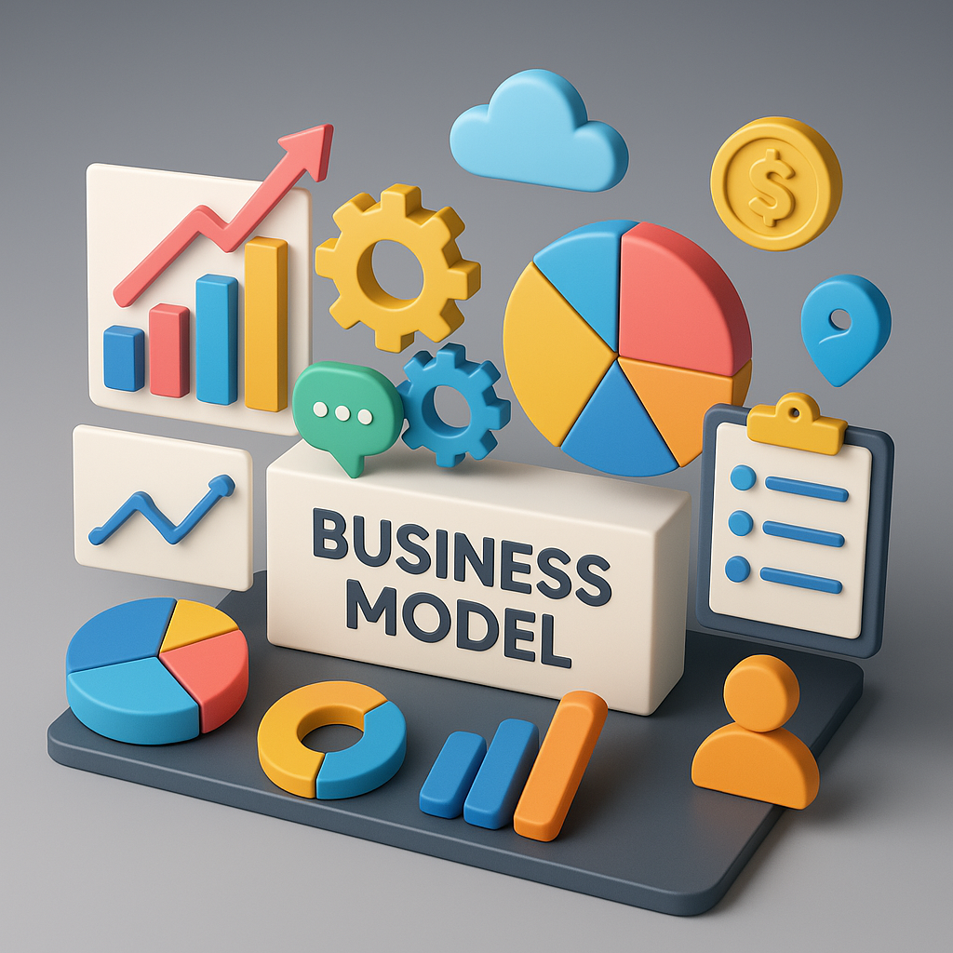
Recap of Day 1
The AI Paradigm Shift
Anatomy of an AI Agent
Communication patterns
Key design principles
Business Model

Slide 6
Design Thinking
02

Slide 7
Design Thinking
The AI Paradigm Shift
What insights did you learn that you could leverage in your design?
Define the problem statement.
Take the solution you landed on from the Ideate section and start building.
Share your prototype for feedback
Get your prototype in front of the people that need this solution.
Capture their feedback and if needed, go back and edit your prototype to make it even better.
Empathize
Ideate
Define
Prototype
Test
What processes do they use today?
Are there any existing points of friction?
What might make their experience better?​
If you had a magic wand to help them, what would happen?
Go for quantity over quality, this is the time to generate ideas, not refine (that'll happen later).
Share your ideas and capture feedback.
Iterate based on feedback.
Reflect and iterate.
To facilitate creative problem solving, let's use the Stanford D-School "Design thinking" methodology. Learn more

Slide 8
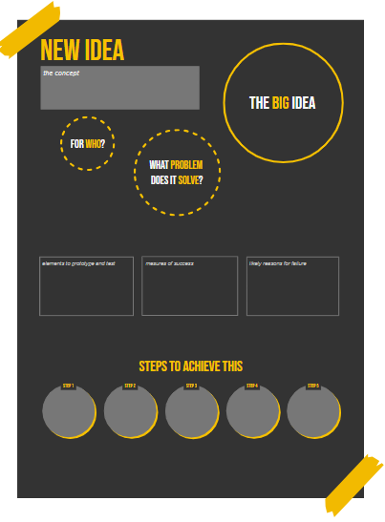
Problem Statement and Ideation​
The AI Paradigm Shift
What’s the north star you are pursuing?
Who’s gonna help?
What’s the business Challenge?
What do we prototype today?
What’s the business Challenge?
Why might it fail?
How do we achieve it?

Slide 9
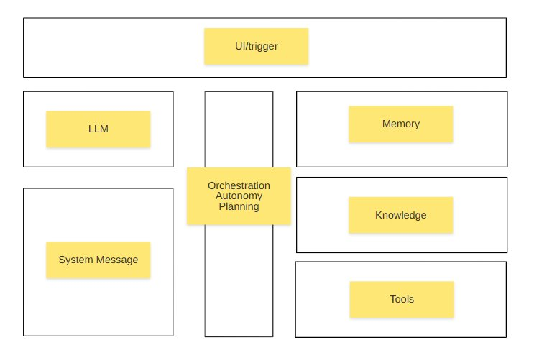
The AI Paradigm Shift
Agent Identikit​​

Slide 10
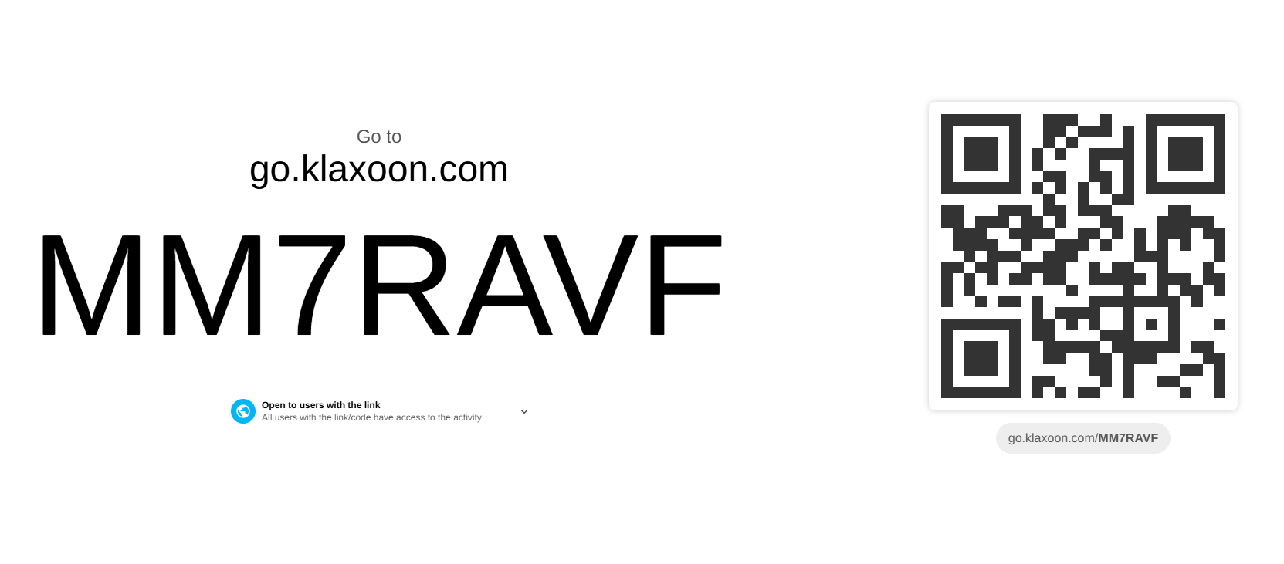
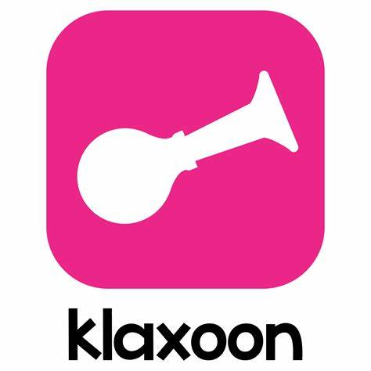
The AI Paradigm Shift
Before Coding…​

Slide 11
Demonstration
03

Slide 12
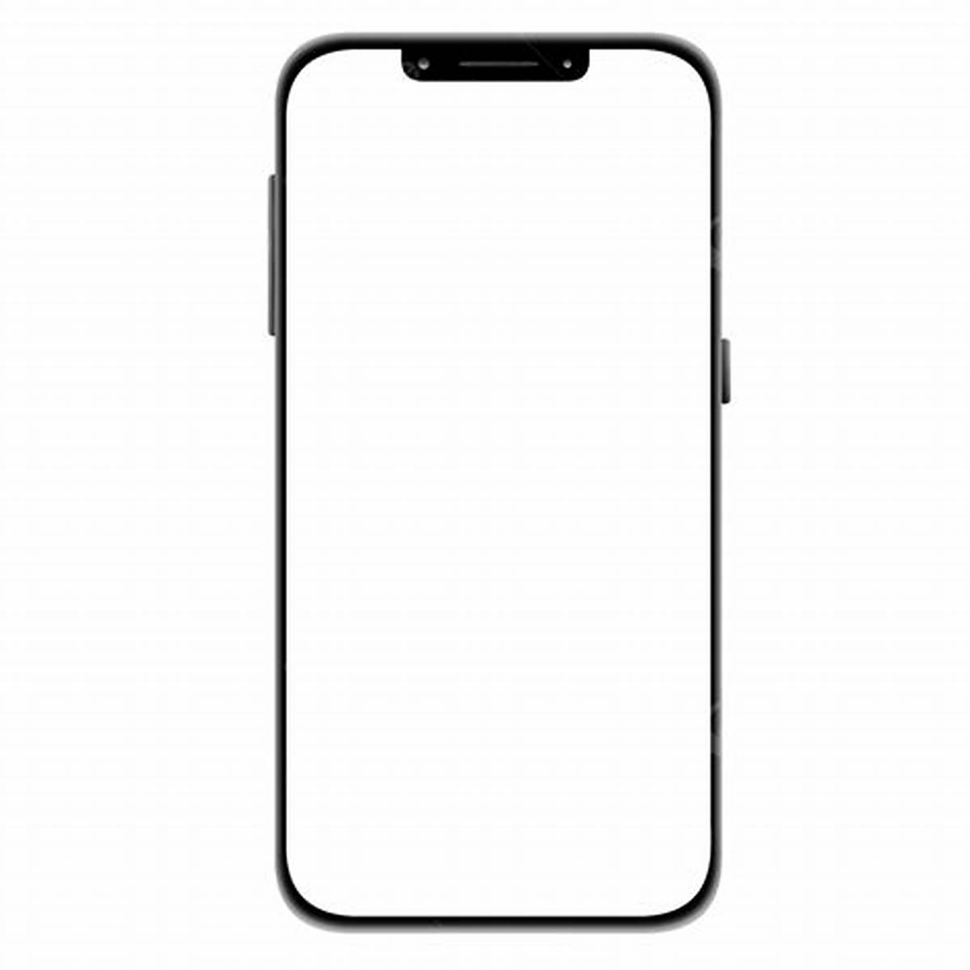
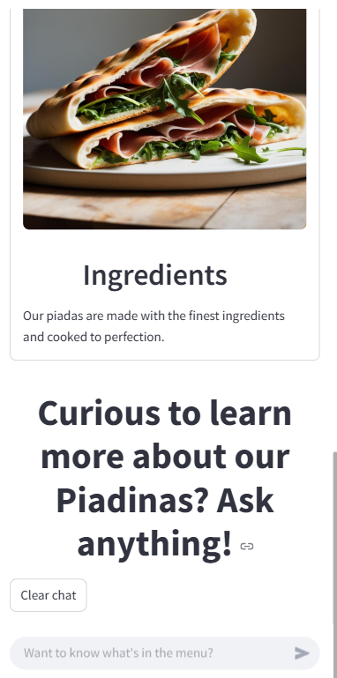
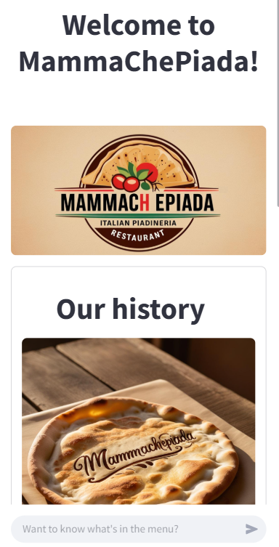
The AI Paradigm Shift

Slide 13
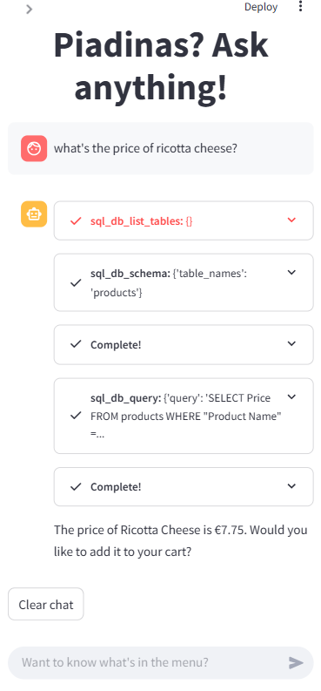
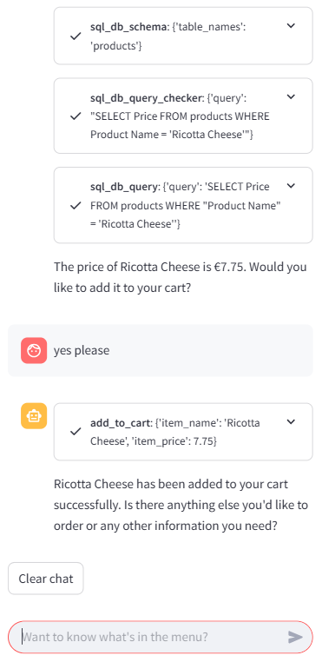
The AI Paradigm Shift

Slide 14
The AI Paradigm Shift
Anatomy of an AI Agentic App​​
UI (optional)
LLM
Memory
Orchestration
Knowledge Base
System Message
Tools

Slide 15
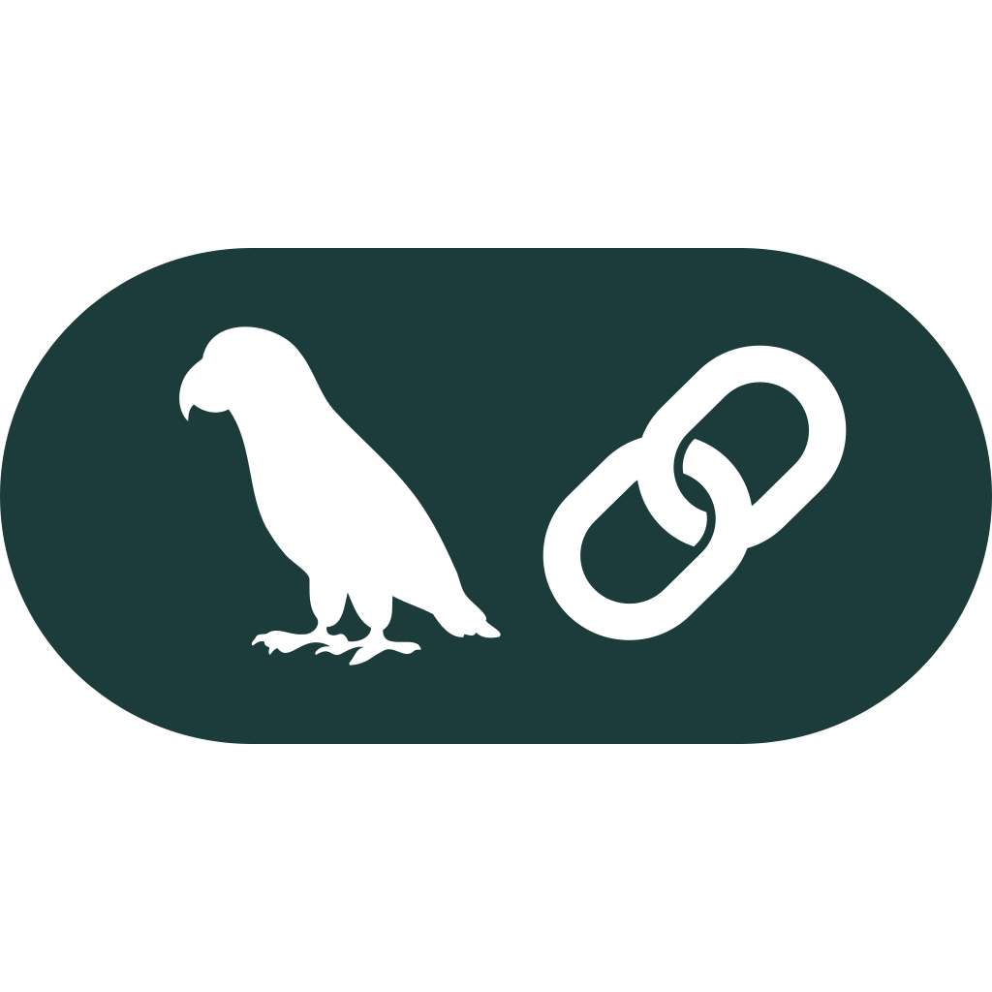

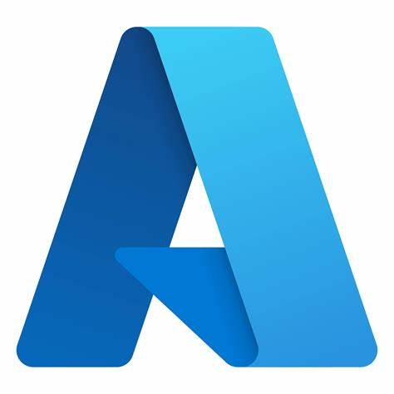

The AI Paradigm Shift
Anatomy of an AI Agentic App​​
📱Mobile App
Azure OpenAI GPT-4o
User session
🗂️
Orchestration
Food safety certificates
You are an AI assistant for a Piadineria Restaurant.
You help customers explore the menu and choose the best piadine or Italian specialties through friendly…..
📖
SQL DB
Add to cart
🗄️
📝
🛒

Slide 16
Time for QnA!
04

Slide 17
AI Agents Open Protocols
05

Slide 18
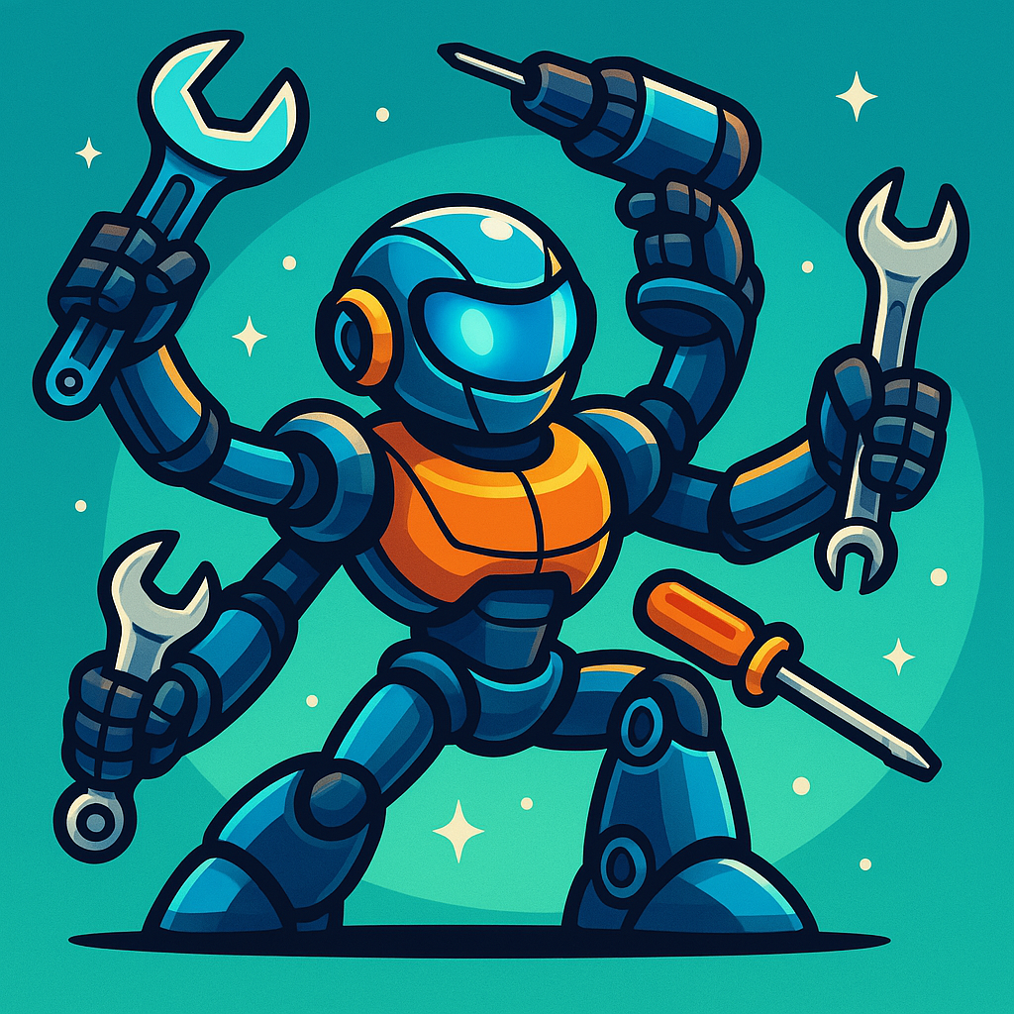
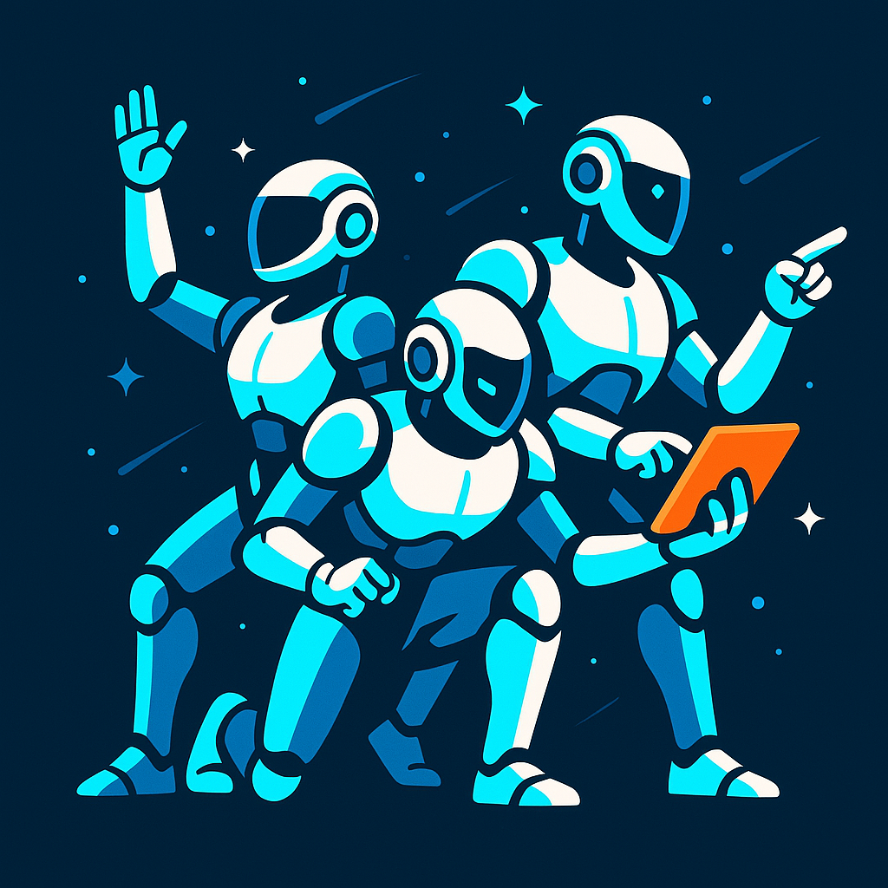
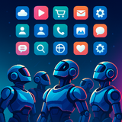
Building LLM-Powered Applications​
AI Agents Open Protocols​
Model Context Protocol
Agent to Agent
NLWeb

Slide 19
Building LLM-Powered Applications​
AI Agents Open Protocols​
Model Context Protocol
Agent to Agent
NLWeb

Slide 20

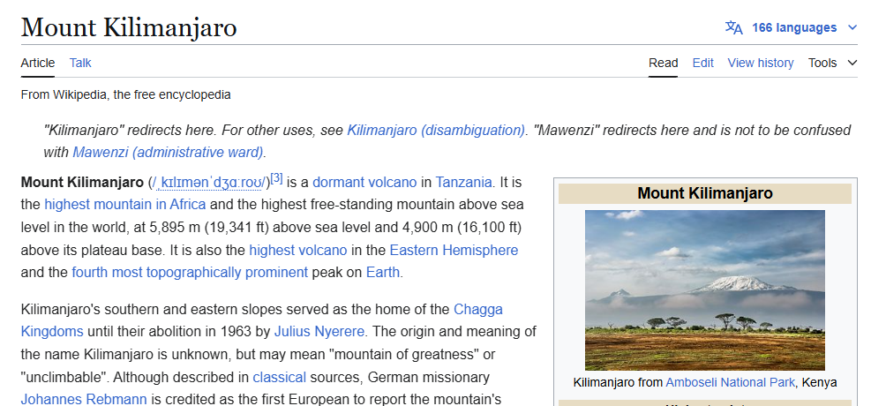
Building LLM-Powered Applications​
What is a protocol?​
http://
HTTP request
GET /wiki/Mount_Kilimanjaro
Browser
http://
HTTP Response
Client
Server

Slide 21



Building LLM-Powered Applications​
What is an API?​
HTTP request
GET /api/mountains/kilimanjaro
HTTP Response
{
"name": "Mount Kilimanjaro",
"elevation": 5895,
"location": "Tanzania"
}
REST Client
Server

Slide 22
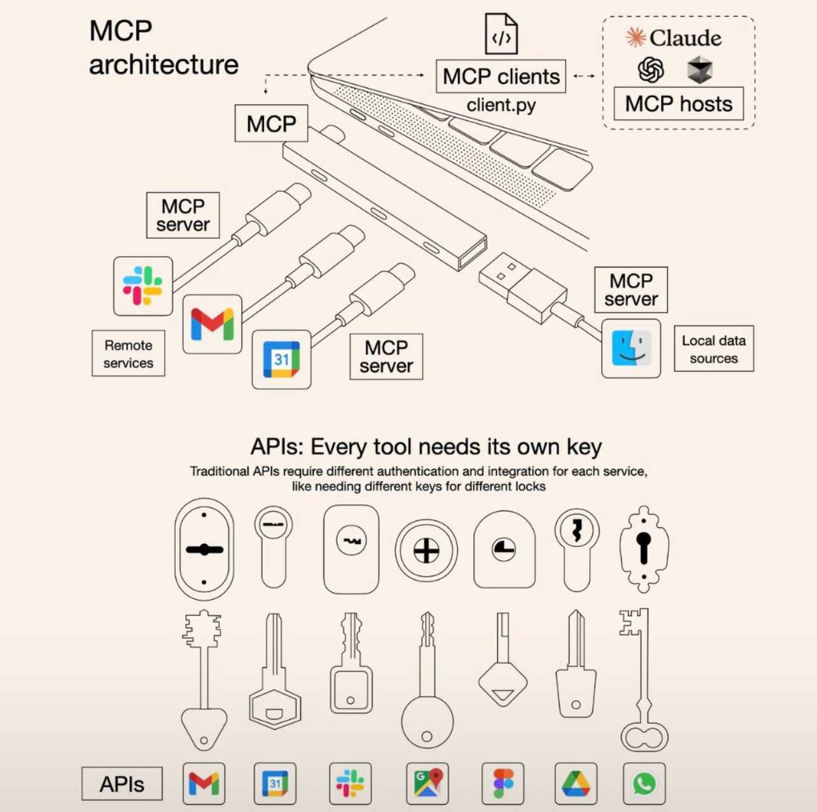
Building LLM-Powered Applications​
Model Context Protocol
“MCP is an open protocol that standardizes how applications provide context to LLMs. Think of MCP like a USB-C port for AI applications. Just as USB-C provides a standardized way to connect your devices to various peripherals and accessories, MCP provides a standardized way to connect AI models to different data sources and tools.”
Source: https://blog.csdn.net/ChailangCompany/article/details/146354913
Source: https://modelcontextprotocol.io/introduction

Slide 23
Building LLM-Powered Applications​
High-Level Architecture of MCP
MCP Server
{ name: string; description?: string; inputSchema: type: "object", properties: { ... } } }
MCP Host
Tool
MCP Client
IN
LLM
MCP Server
{ uri: string; name: string; description?: string; mimeType?: string; }
Resource
OUT
{ name: string; description?: string; arguments?: [ { name: string; description?: string; required?: boolean; } ] }
MCP Server
Prompt

Slide 24
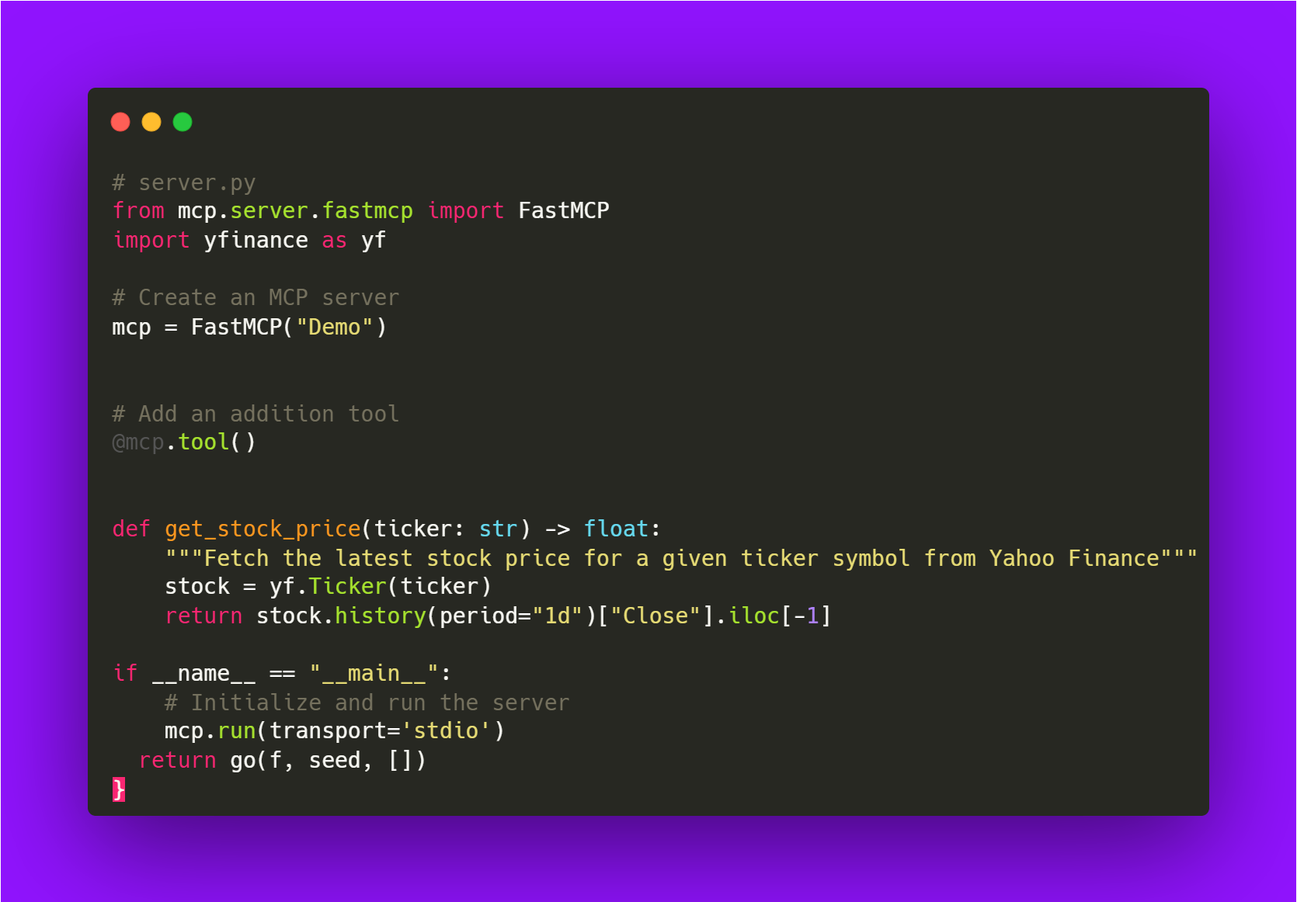

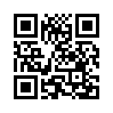
Building LLM-Powered Applications​
Example – Weather Forecast MCP Server
Claude Desktop as MCP Host
💻
Local Machine as MCP Server, using Python SDK
Tip: Find a catalog of MCP Servers here!
Source: https://mcpservers.org/

Slide 25
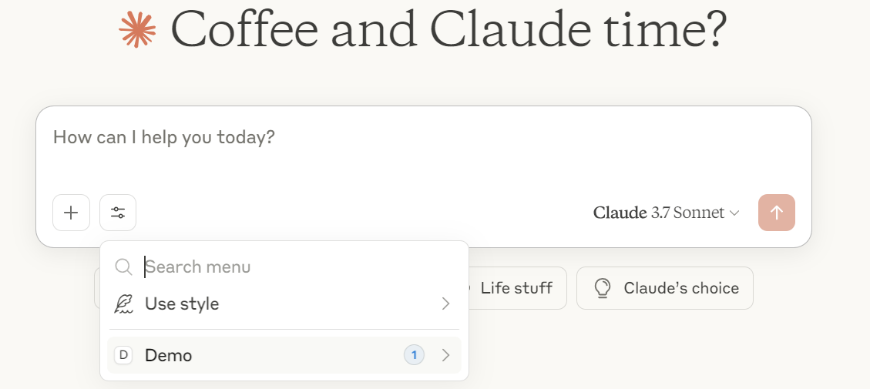
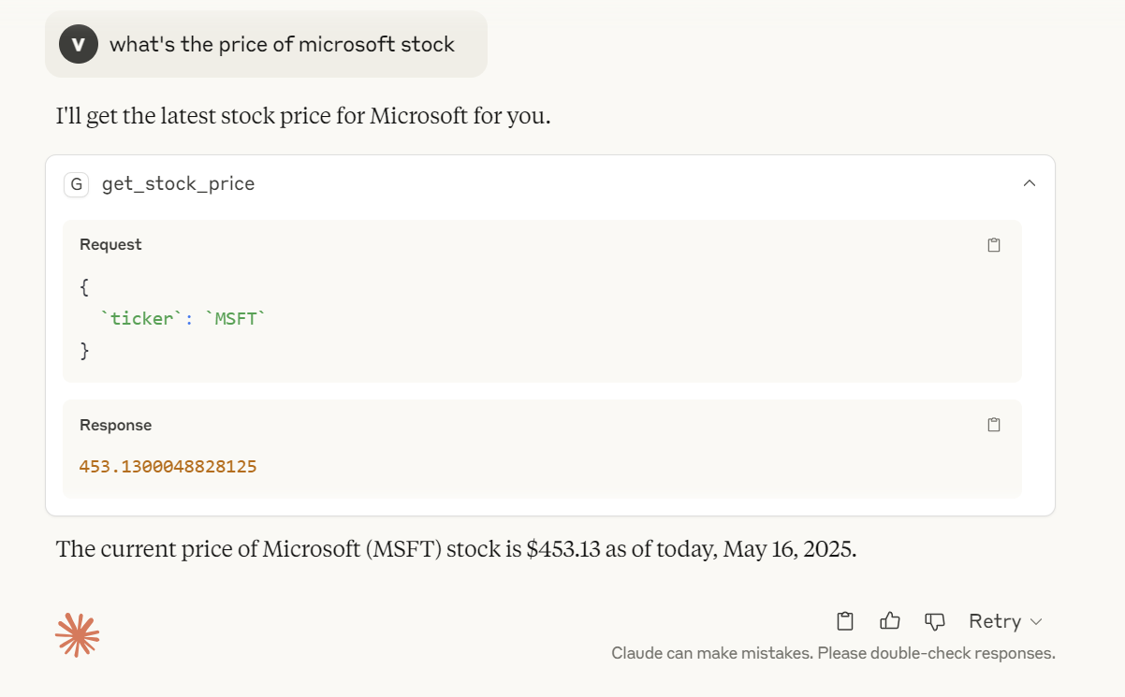
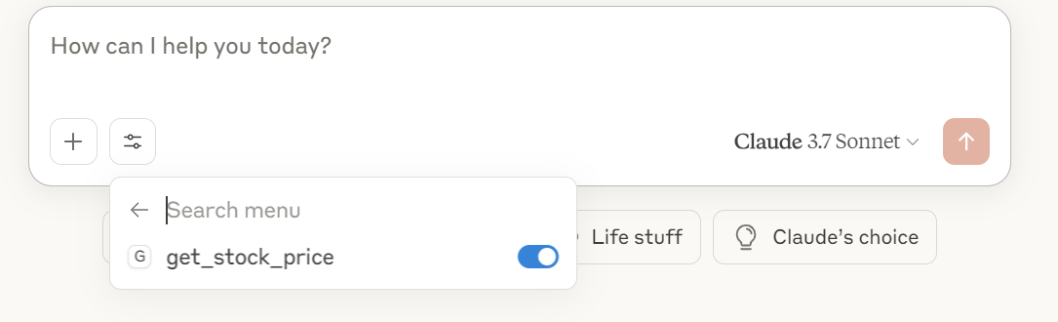
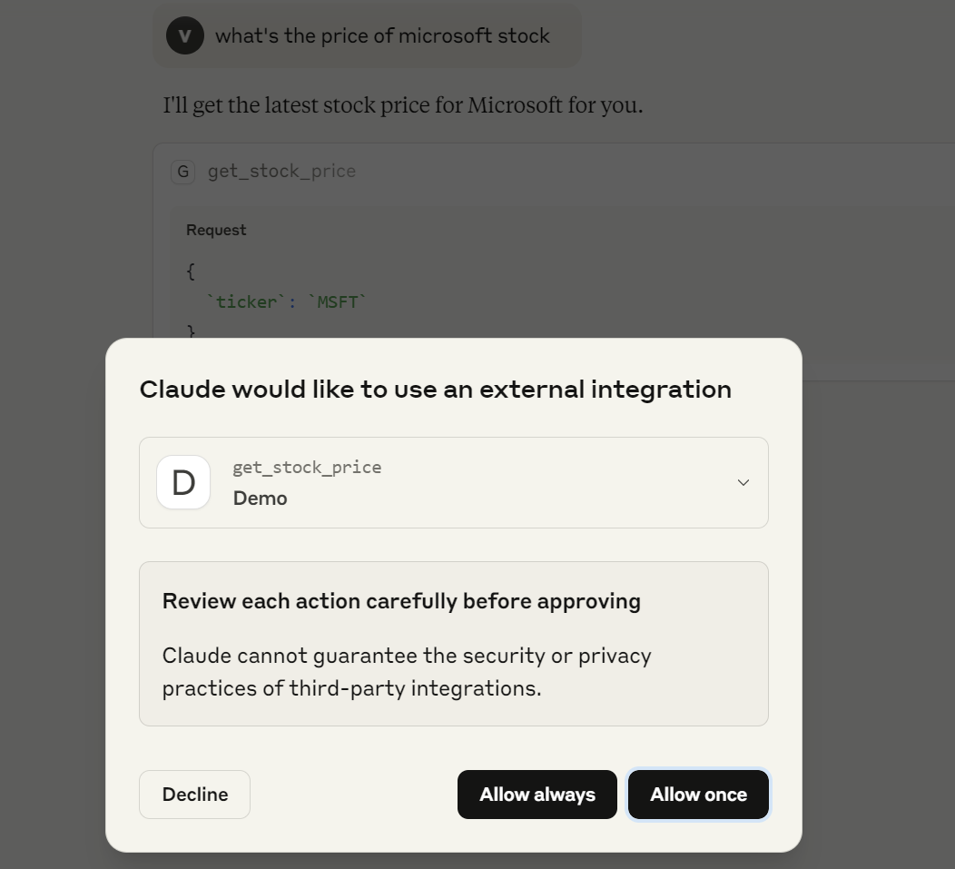
Building LLM-Powered Applications​

Slide 26
Building LLM-Powered Applications​
AI Agents Open Protocols​
Model Context Protocol
Agent to Agent
NLWeb

Slide 27
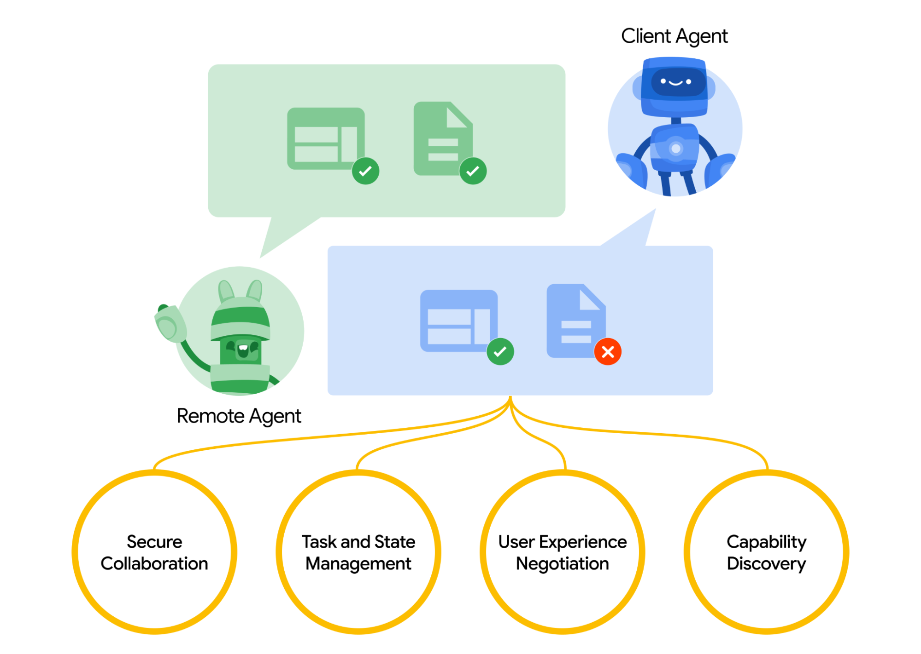
Building LLM-Powered Applications​
Agent to Agent
“A2A Protocol is an open standard that enables AI agents to communicate and collaborate across different platforms and frameworks, regardless of their underlying technologies. It's designed to maximize the benefits of agentic AI by enabling true multi-agent scenarios.”
Image source: https://a2aprotocol.ai/
Source: https://a2aprotocol.ai/

Slide 28
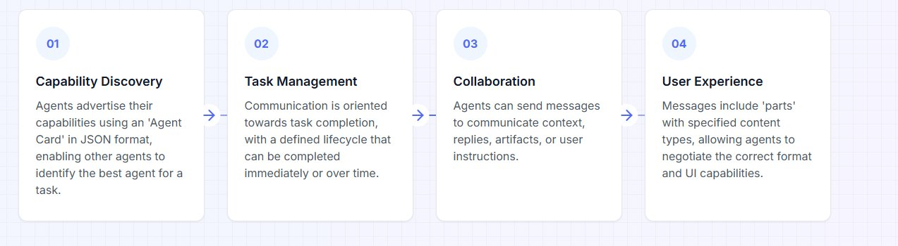
Building LLM-Powered Applications​
How does it work?

Slide 29
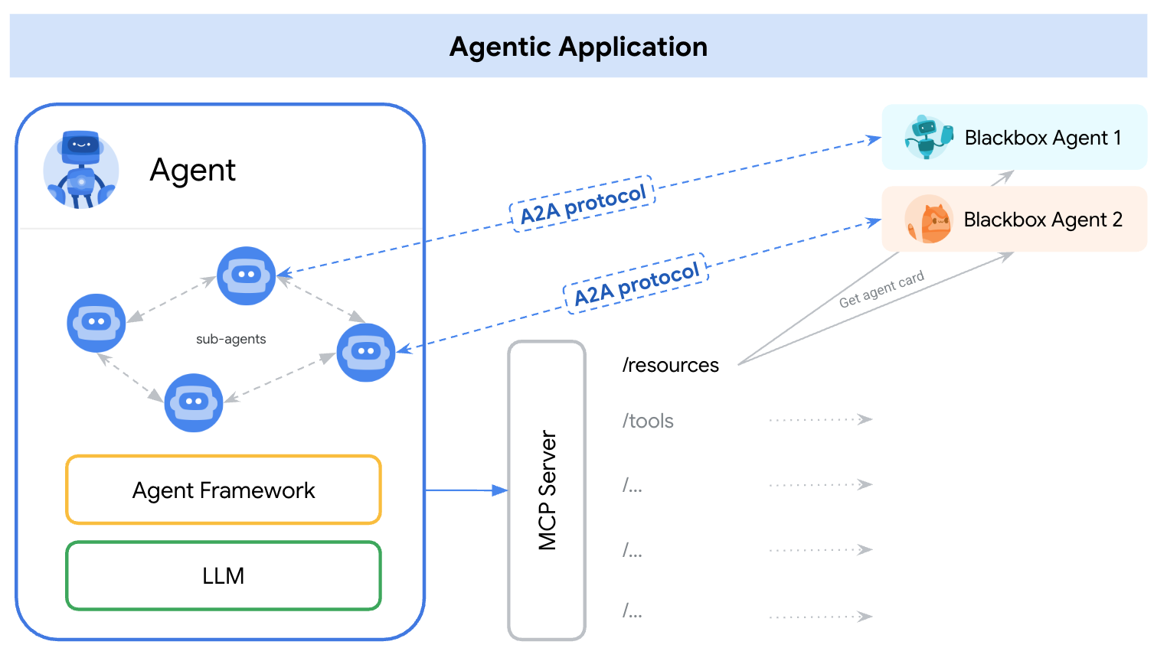
Building LLM-Powered Applications​
A2A vs MCP
MCP
Protocol to connect LLMs with Data, Resources and Tools.
Protocol to connect and enable collaboration among multiple agents.
A2A

Slide 30
Building LLM-Powered Applications​
AI Agents Open Protocols​
Model Context Protocol
Agent to Agent
NLWeb

Slide 31
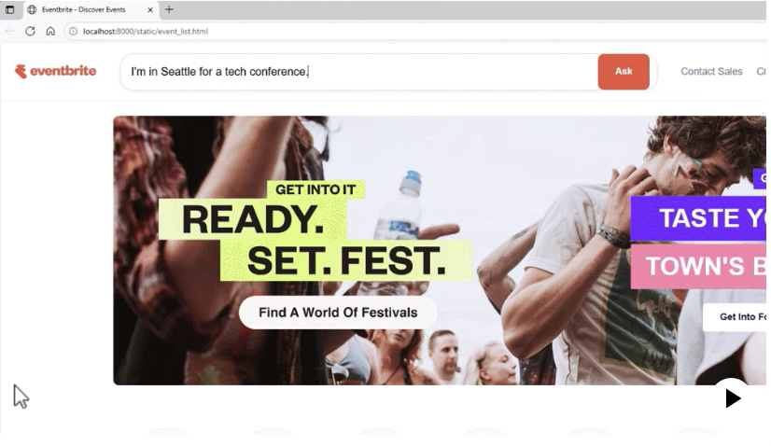
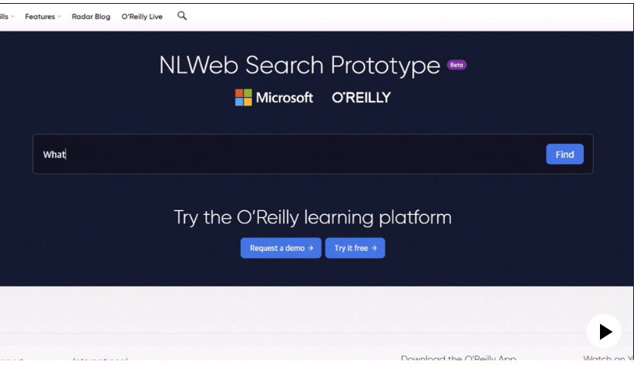
Building LLM-Powered Applications​
What’s NLWeb?
“Building conversational interfaces for websites is hard. NLWeb seeks to make it easy for websites to do this. And since NLWeb natively speaks MCP, the same natural language APIs can be used both by humans and agents.”
Source: https://news.microsoft.com/source/features/company-news/introducing-nlweb-bringing-conversational-interfaces-directly-to-the-web/?msockid=16ccd88e67d963500e5fcd7866d062ac
Source: https://github.com/microsoft/nlweb

Slide 32
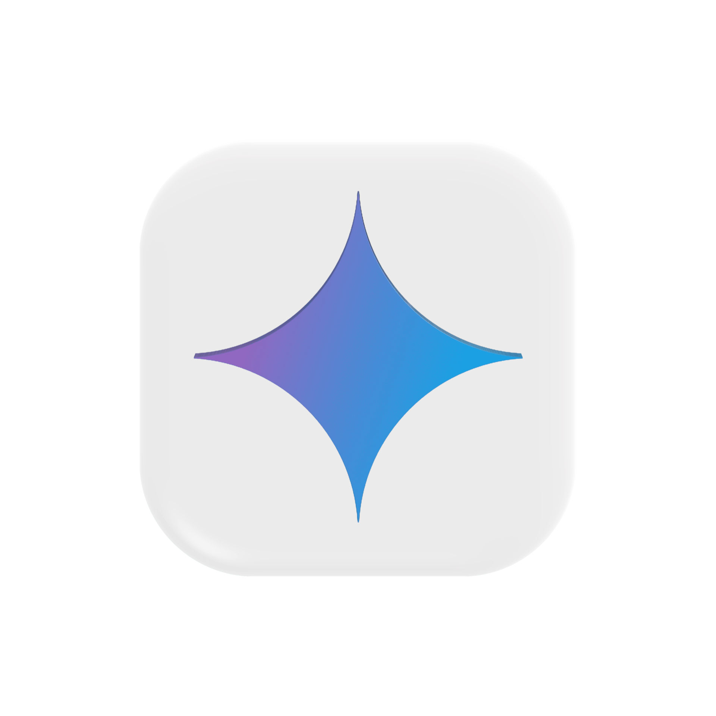

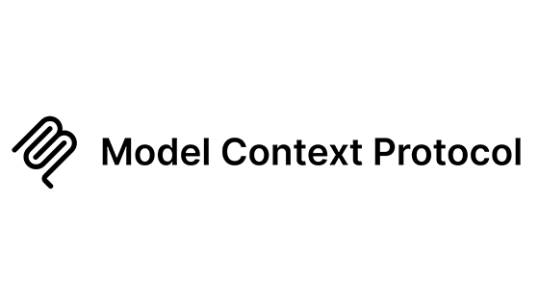
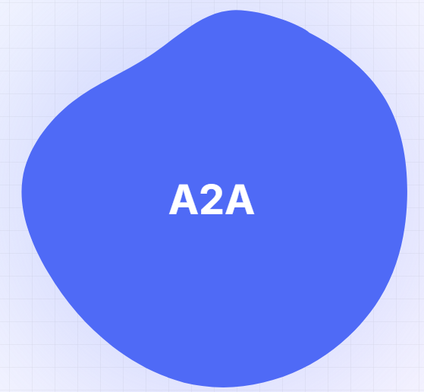
Building LLM-Powered Applications​
Building the Open Agentic Web
Agent
Agent
Agent
Agents
🛠
🛠
🛠
📝
📝
📝
…..
Runtime
🛠
🧠
It’s like HTTP!
🗂️
Reasoning
…..
Memory
Tools
Entitlement
Protocols
….
🌐
💻
Web
Apps
Other Agents
The World
🤖
Source: https://github.com/microsoft/nlweb

Slide 33




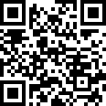


Questions
05
Let’s keep in touch!

Slide 34
Thank You!
06

